Slide 1
Region Filling Algorithm
Md. Manirujjaman
Lecturer, Dept of CSE

Slide 2
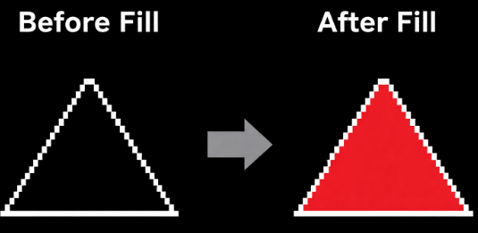
Region filling is the process of “coloring in” a definite image area or region, or we can say it is the process of coloring or filling the inerior of a closed boundary in computer graphics.
A region is an area surrounded by a boundary.
Filling means assigning a specific color to all pixels inside that boundary.

Slide 3
Why Region Filling is Needed ?
In computer graphics, many objects are defined only by their boundaries or edges.
To display solid objects, we must fill the area inside the boundary.
Region filling is used to:
Color shapes
Render solid objects
Display filled polygons
Perform image editing

Slide 4
Real-World Applications
Region filling algorithms are widely used in many software systems:
Painting Software
MS Paint
Photoshop
GIMP
Computer Aided Design (CAD)
Filling mechanical parts
Coloring design surfaces
Image Processing
Segmenting objects in images

Slide 5
Boundary Fill Algorithm
Boundary Fill is a region filling algorithm that fills an area until it reaches a specified boundary color. It starts from a seed point located inside the region. The algorithm fills neighboring pixels until the boundary is reached.

Slide 6
Concept
Boundary fill requires two colors:
Boundary Color
Fill Color
The algorithm continues filling pixels while they are not boundary color.
BBBBBBBB
BCCCCCCB
BCCSCCCB
BCCCCCCB
BBBBBBBB
B = Boundary
S = Seed point
The algorithm fills all pixels inside the boundary.

Slide 7
How Boundary Fill Works
Steps:
Choose a seed point inside the region
Check if the pixel is boundary color
If not boundary → fill it
Repeat the process for neighboring pixels
Continue until the boundary is reached
Advantages
Easy to implement
Works well for simple shapes
Limitations
Requires a closed boundary
Can cause stack overflow when using recursion
Slow for very large regions

Slide 8
Types of Boundary Fill
There are two main implementations:
Recursive Boundary Fill
Stack-Based Boundary Fill

Slide 9
Recursive Algorithm Steps
BoundaryFill(x,y)
{
If pixel(x,y) is boundary color
return
If pixel(x,y) is already filled
return
Set pixel(x,y) = fill color
BoundaryFill(x+1, y)
BoundaryFill(x-1, y)
BoundaryFill(x, y+1)
BoundaryFill(x, y-1)
}

Slide 10
Problem with Recursive Method
Recursion Depth Error : Because thousands of recursive calls may occur.
Therefore recursion is mainly used for conceptual understanding.

Slide 11
Stack-Based (Non-Recursive) Boundary Fill
Instead of recursion, we use a stack data structure. The stack stores pixels that still need to be processed.This avoids recursion depth problems.
Why Stack Method is Used ?
Recursive method problems:
Stack overflow
Limited recursion depth
Stack-based method advantages:
More stable
Works for large regions
Used in real applications

Slide 12
Stack-Based Algorithm Steps
BoundaryFill(seed)
1. Create empty stack
2. Push seed point into stack
3. While stack is not empty:
Pop point (x,y)
If pixel is boundary → continue
If pixel already filled → continue
Fill pixel
Push neighbors:
(x+1,y)
(x-1,y)
(x,y+1)
(x,y-1)

Slide 13
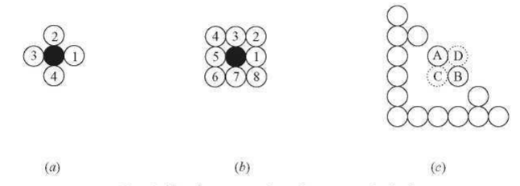
Using 4-neighbor filling instead of 8-neighbor filling because it is safer and prevents diagonal leakage through corner gaps in the boundary.

Slide 14
Thank You

